Slide 1

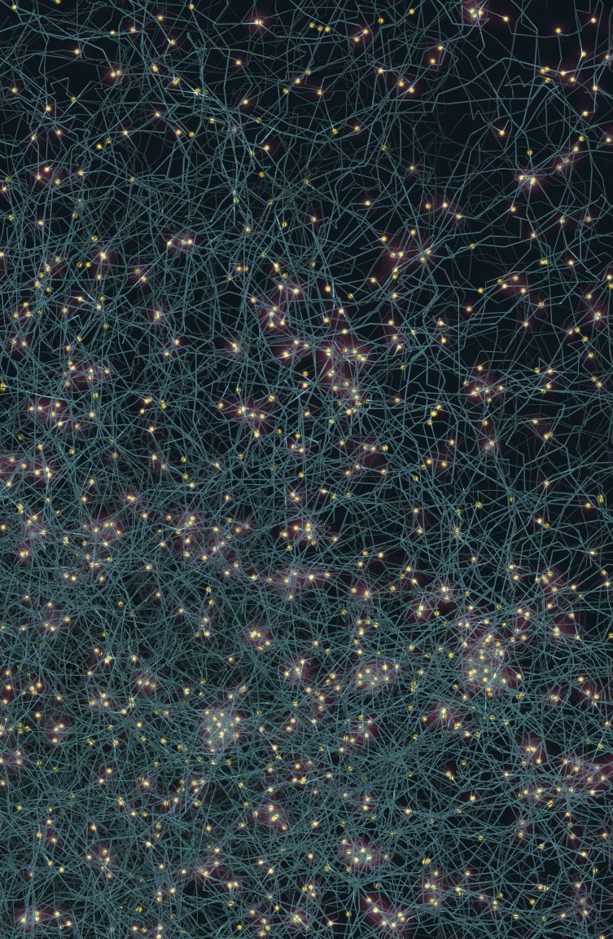
DEEP NEURAL NETWORKS - CIFAR 10 CLASSIFICATION
PRESENTED BY:
FNU ANVIKA (A20556800)
SATWIKA SRIRAM(A20563950)

Slide 2
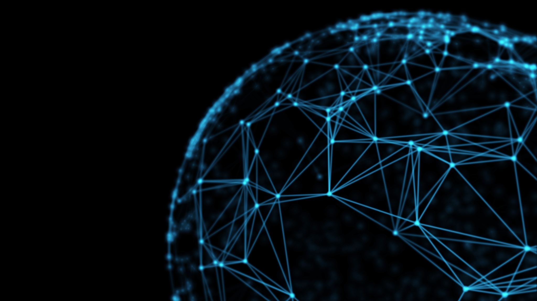



OBJECTIVE
Improve efficiency of CNN models
Enhance generalization
Persist models
Optimize network weights and use regularization techniques like dropout
Perform data augmentation on images
Save and retrieve trained CNN networks
The objective is to optimize simple CNN models for classifying CIFAR-10 images and improve their efficiency.

Slide 3
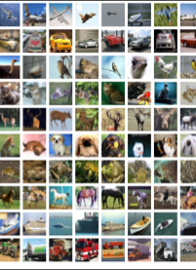




PROJECT OVERVIEW
CIFAR-10 is a dataset that consists of several images divided into the following 10 classes:
Airplanes, Cars, Birds, Cats, Deer, Dogs, Frogs, Horses, Ships, and Trucks.
The dataset stands for the Canadian Institute For Advanced Research (CIFAR)
CIFAR-10 is widely used for machine learning and computer vision applications.
The dataset consists of 60,000 32x32 color images, 6,000 images of each class.
Images have low resolution (32x32).
Data Source: https://www.cs.toronto.edu/~kriz/cifar.html

Slide 4
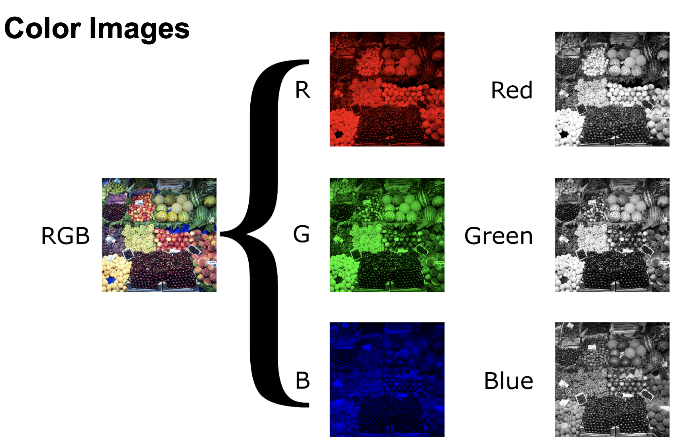
Each image has three channels – Red, Green and Blue.

Slide 5
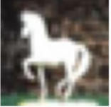
PROJECT OVERVIEW
Image classification is the task of taking an input image and
outputting a class or a probability of classes
that best describes the image.
TARGET CLASSES
Airplanes
Cars
Birds
Cats
Deer
Dogs
Frogs
Horses
Ships
Trucks
classifier
CIFAR-10 Dataset consists of 60,000 images
• 50,000 training
•10,000 testing
Images are 32x32 pixels (colored)

Slide 6
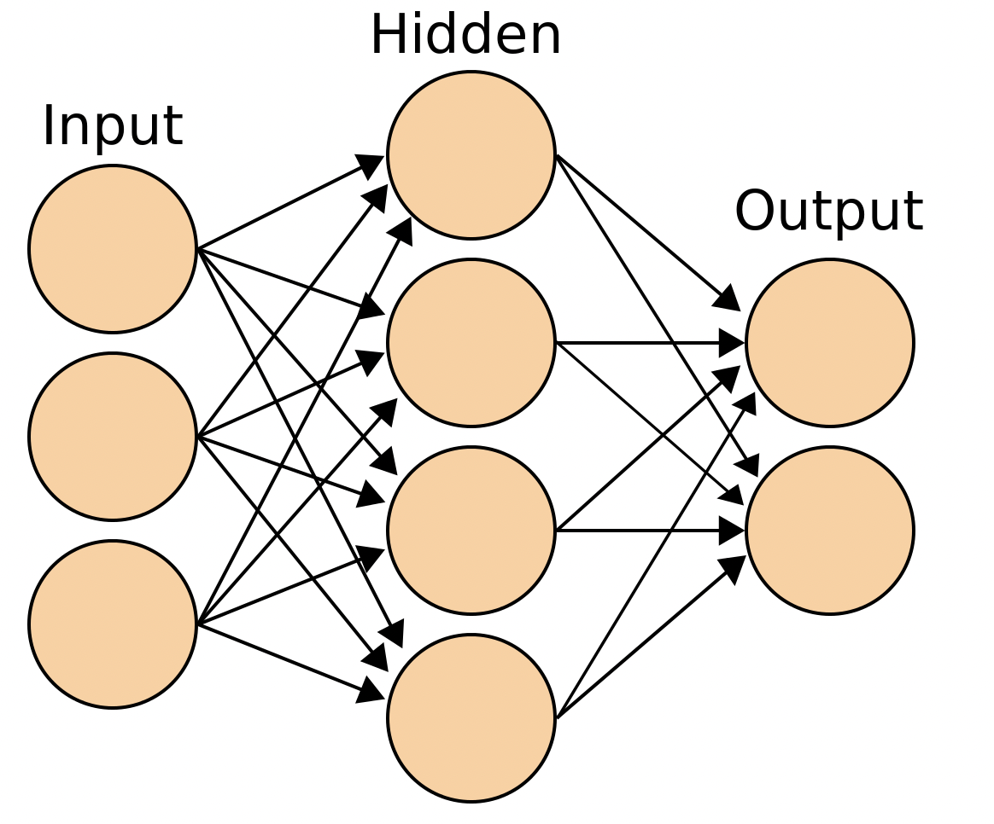
CNN: ENTIRE NETWORK OVERFLOW
Convolution layer
Pooling layer
TARGET CLASSES
Airplanes
Cars
Birds
Cats
Deer
Dogs
Frogs
Horses
Ships
Trucks
Kernels/
feature detectors
Pooling features
convolution
pooling
flattening

Slide 7
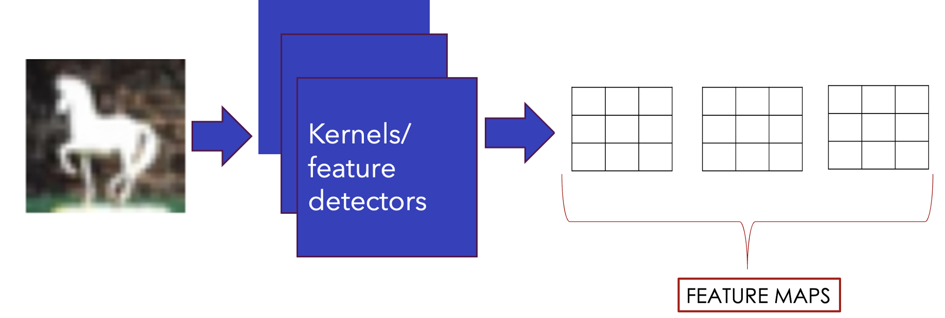
FEATURE DETECTORS
Convolutions use a kernel matrix to scan a given image and apply a filter to obtain a certain effect.
An image Kernel is a matrix used to apply effects such as blurring and sharpening.
Kernels are used in machine learning for feature extraction to select most important pixels of an image.
Convolution preserves the spatial relationship between pixels.

Slide 8
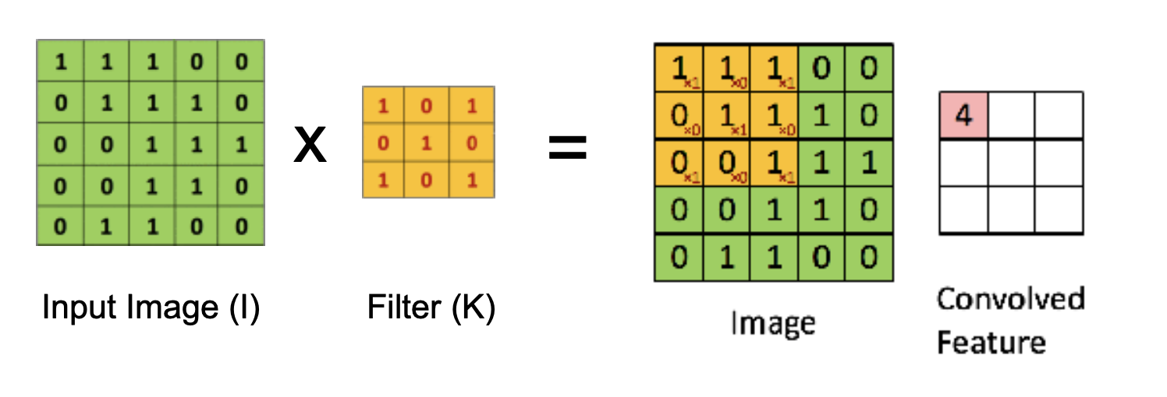
FEATURE DETECTORS
The 3x3 matrix (K) is called a 'filter' or 'kernel' or 'feature detector' and the matrix formed by sliding the filter over the image and computing the dot product is called the 'Convolved Feature’ or 'Activation Map' or the 'Feature Map'.

Slide 9
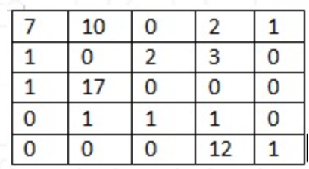
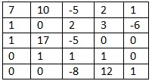
ACTIVATION FUNCTION(RELU)
An additional operation called Rectified Linear Unit (ReLU) has been used after every Convolution operation .
Basically, ReLU is an element wise operation (applied per pixel) and replaces all negative pixel values in the feature map by zero .
The purpose of ReLU is to introduce non-linearity to the network .
f(y)
f(y) = y
y
f(y) = 0

Slide 10
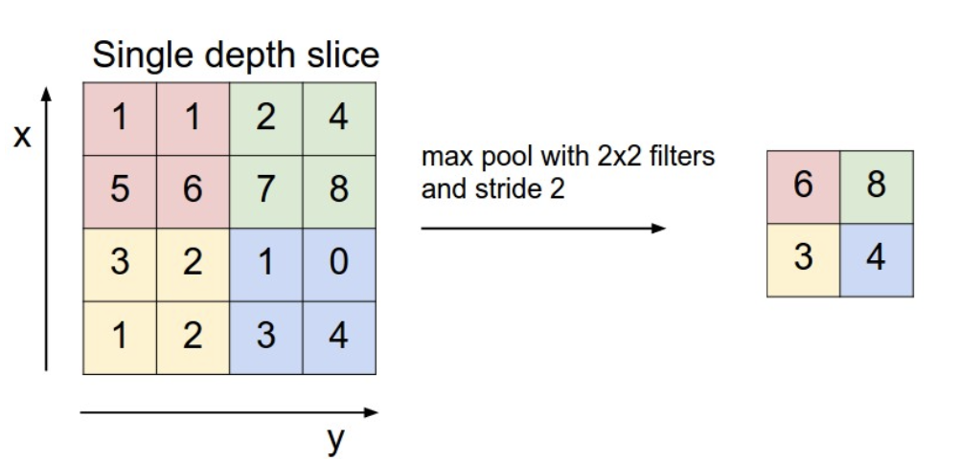
MAX POOLING(SUBSAMPLING)
Pooling or down sampling layers are placed after convolutional layers to reduce feature map
dimensionality.
• This improves the computational efficiency while preserving the features.
• Pooling helps the model to generalize by avoiding overfitting.
• If one of the pixel is shifted, the pooled feature map will still be the same.
• Max pooling works by retaining the maximum feature response within a given sample size in a
feature map.
FLATTENING
6
8
3
4

Slide 11
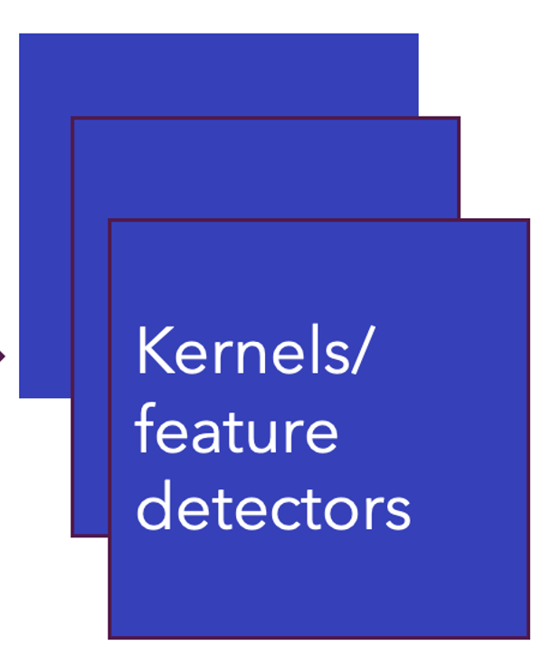
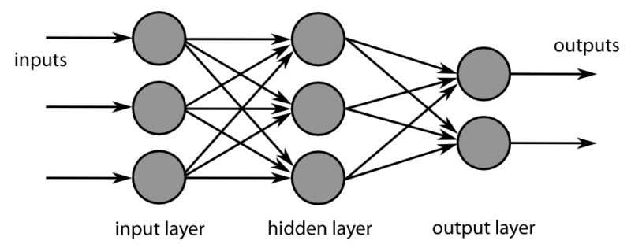

INCREASE FILTERS/DROPOUT
Improve accuracy by adding more feature detectors/filters or adding a dropout.
• Dropout refers to dropping out units in a neural network.
• Neurons develop co-dependency amongst each other during training
• Dropout is a regularization technique for reducing overfitting in neural networks.
• It enables training to occur on several architectures of the neural network
64 instead of 32

Slide 12
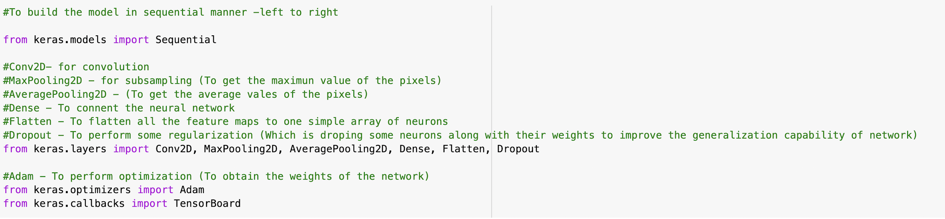
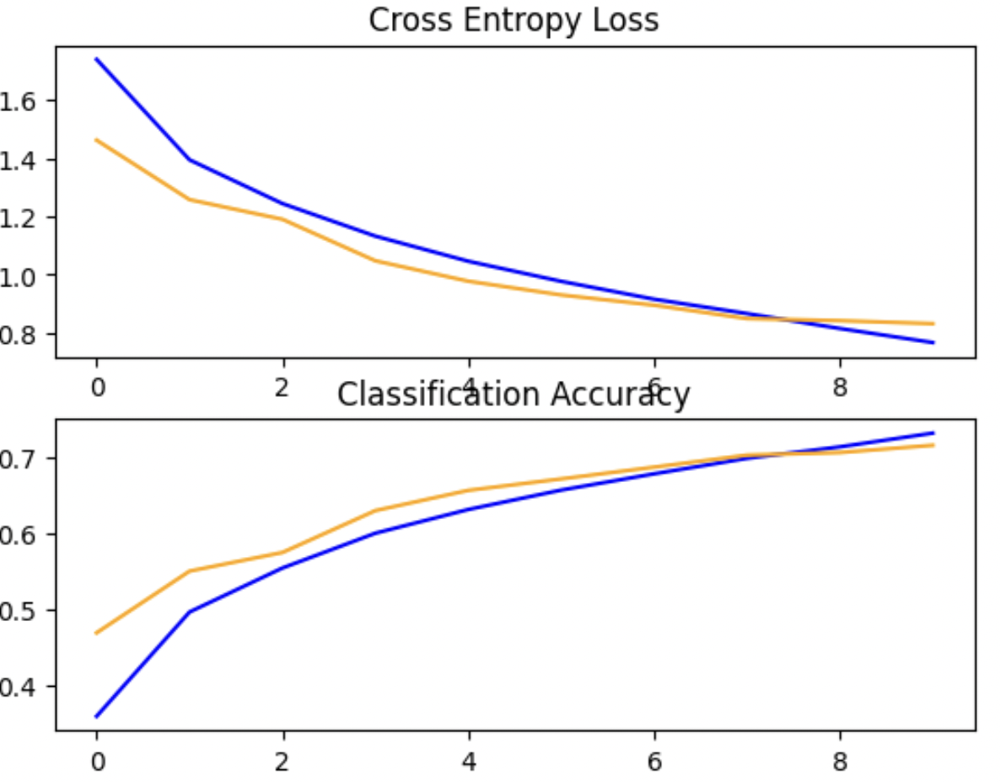
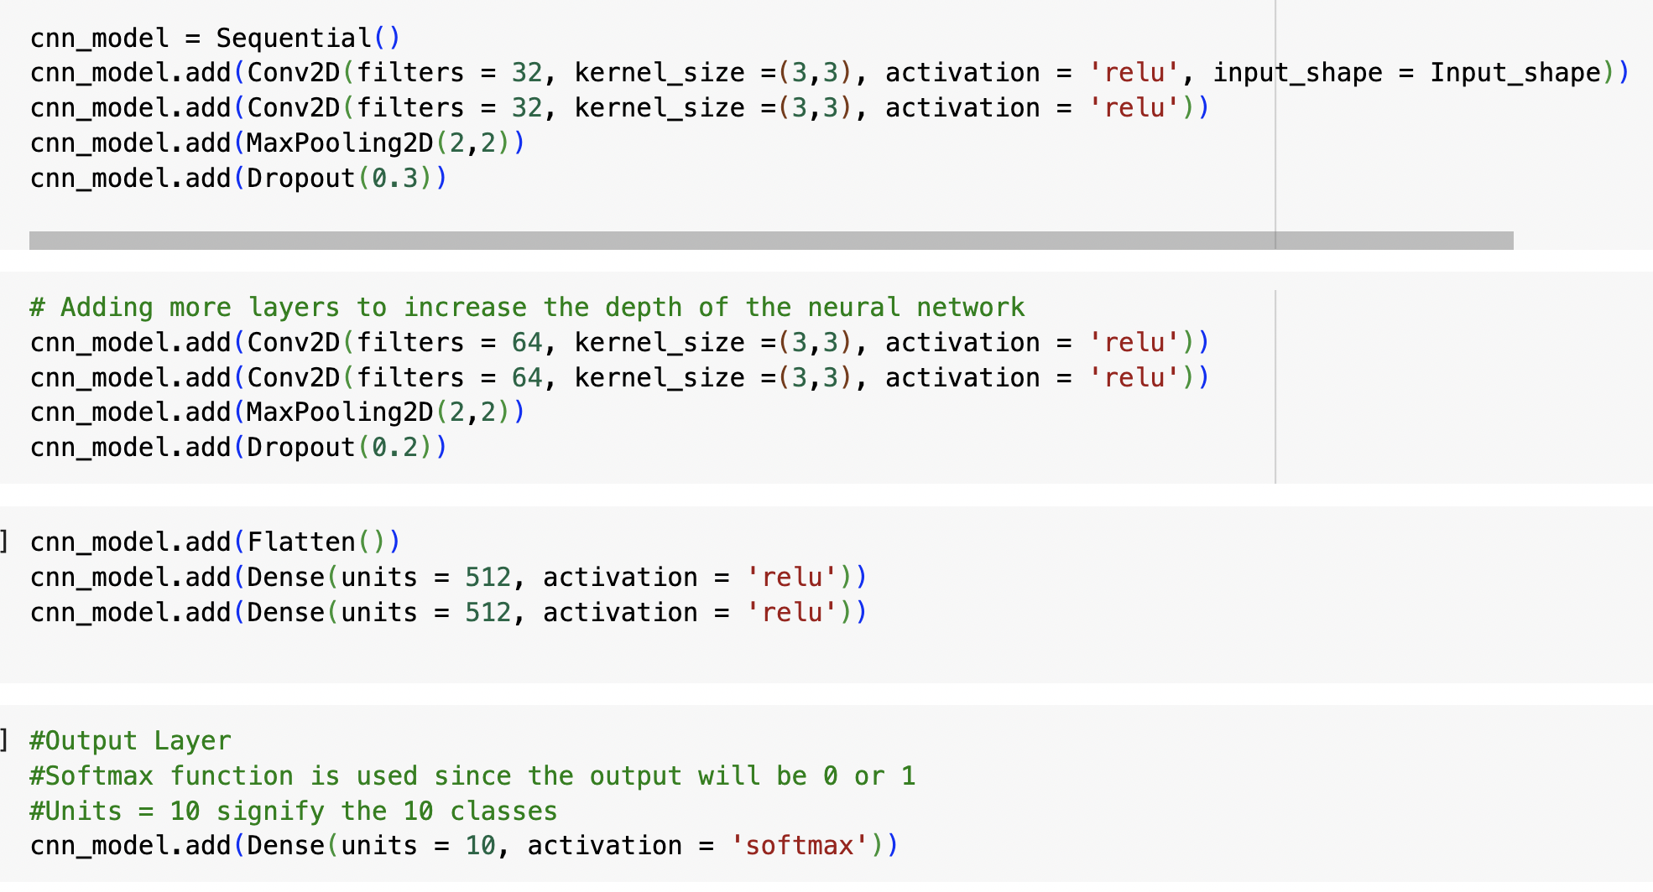
SIMPLE CNN MODEL

Slide 13
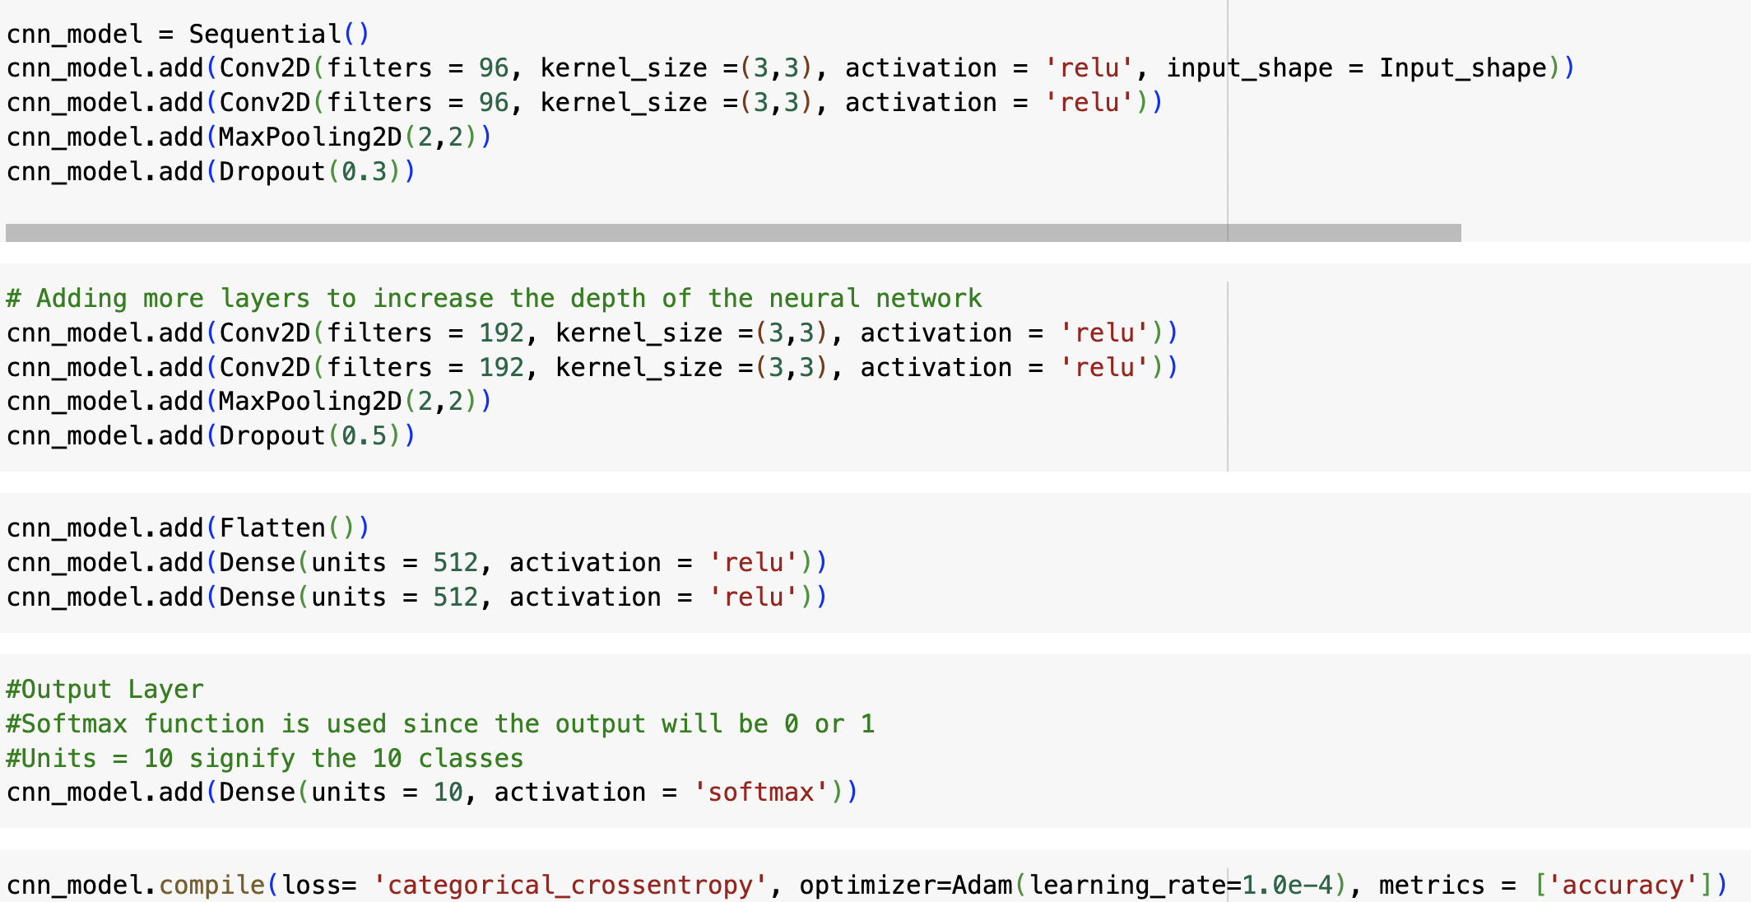
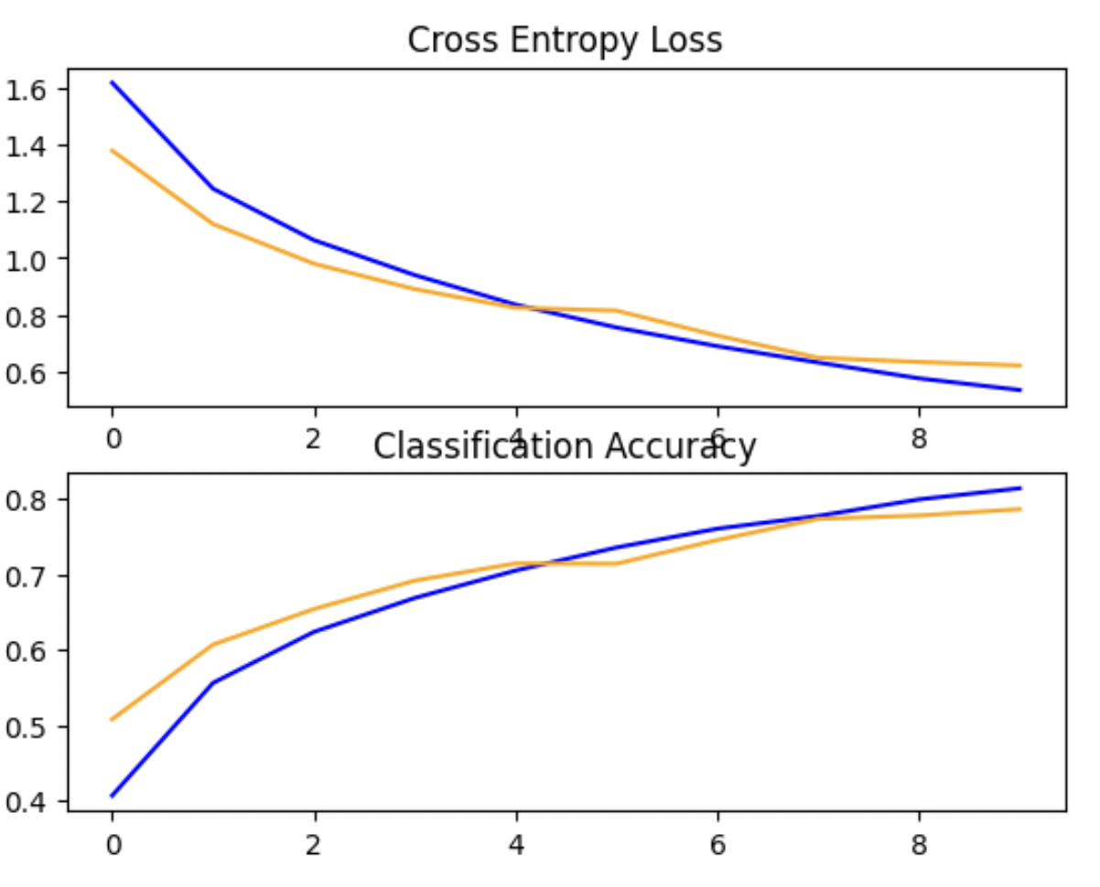
IMPROVED CNN MODEL

Slide 14
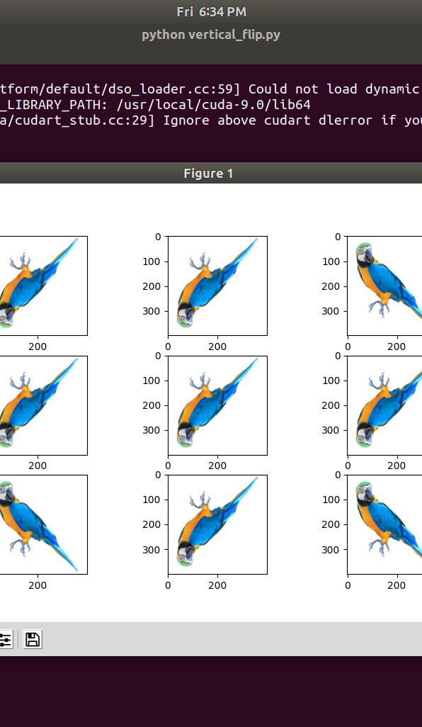
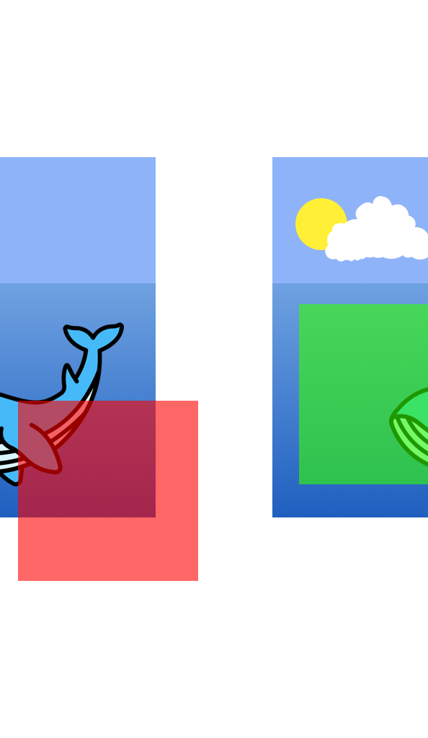
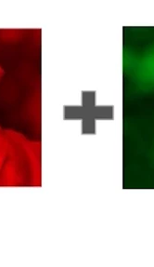
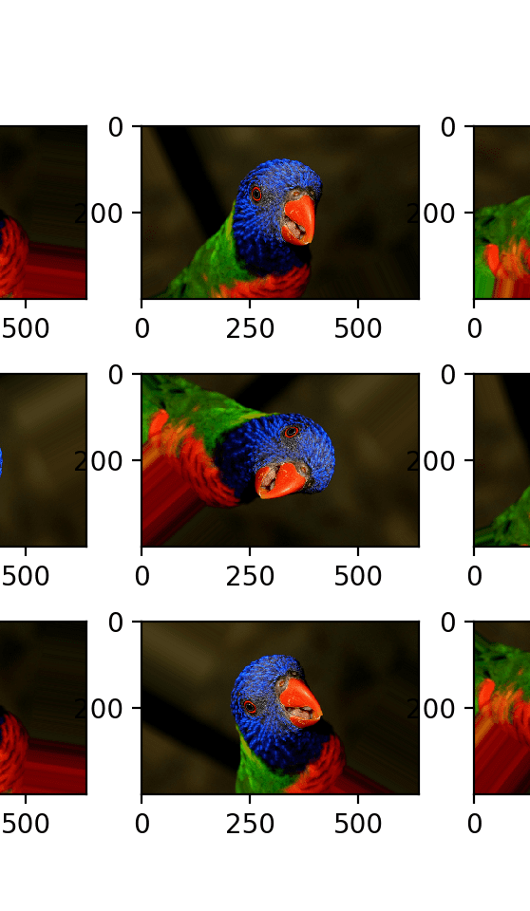
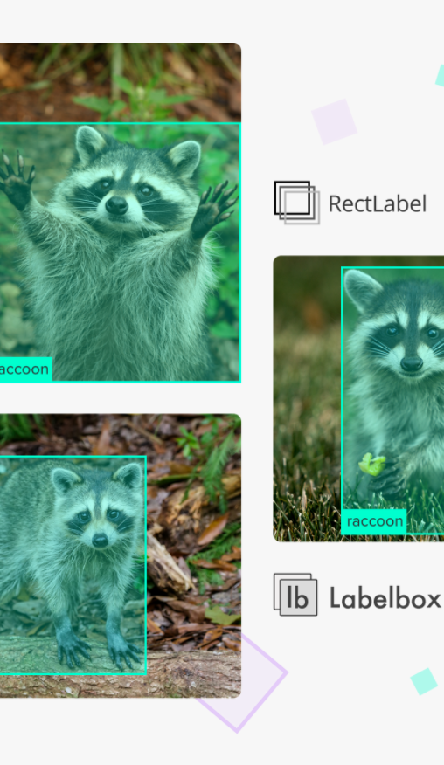
Data Augmentation
Flipped Image
Cropped Image
Color Jittering
Rotation
Scaling
Horizontally flipping the original image to double the dataset.
Random cropping and resizing original images to extract more focused features.
Randomly changing brightness, contrast, saturation of images to reduce overfitting.
Rotating the original image by a few degrees to create more variety in data.
Resizing the original image by slightly zooming in/out to create more sample variety.

Slide 15
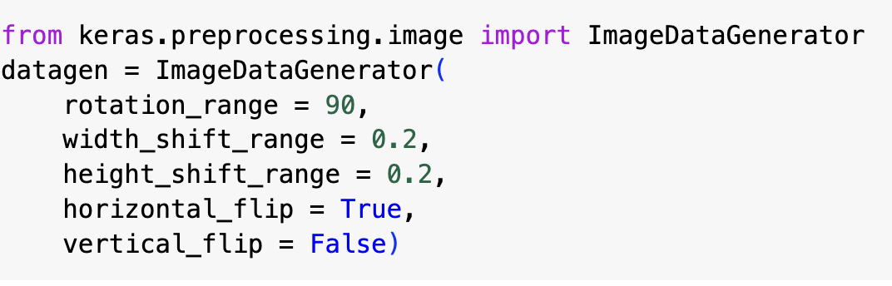

Slide 16
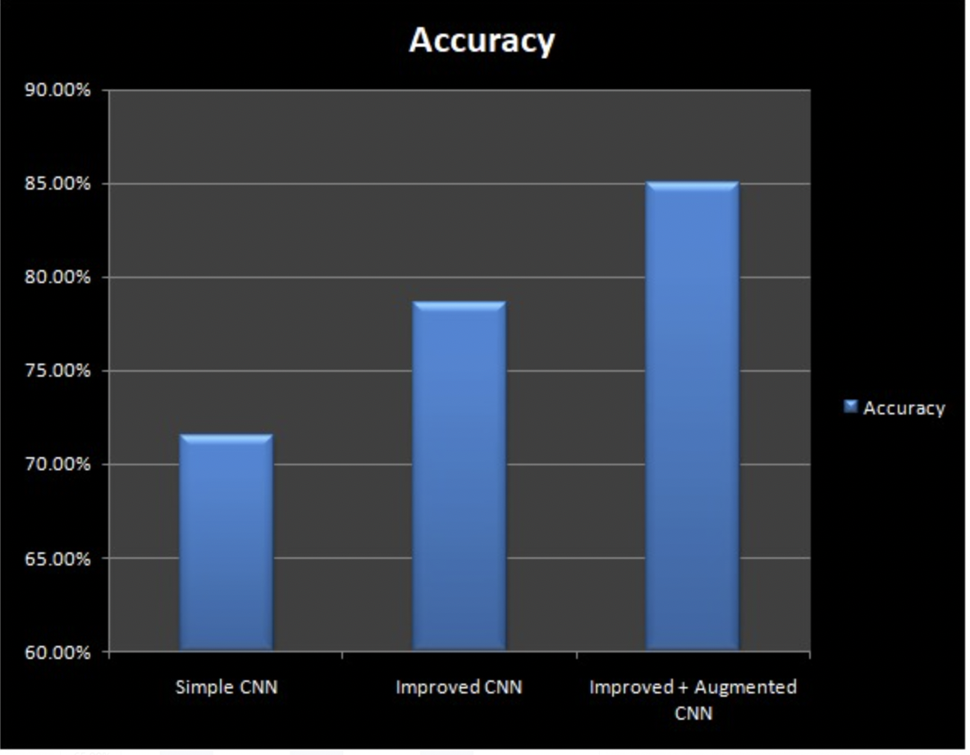
ACCURACY OF CNN MODELS

Slide 17
BOOST OUTCOMES
• RUN THE ENHANCED MODEL FOR A GREATER NUMBER OF EPOCHS.
• APPLY TRANSFER LEARNING BY ADDING YOUR OWN NETWORK TO AN ALREADY-EXISTING, PRE-TRAINED NETWORK.

Slide 18

REFERENCES
1.Doon, R., Kumar Rawat, T., & Gautam, S. (2018). Cifar-10 Classification using Deep Convolutional Neural Network. In 2018 IEEE Punecon. 2018 IEEE Punecon. IEEE. https://doi.org/10.1109/punecon.2018.8745428.
2.Aslam, S., & Nassif, A. B. (2023). Deep learning based CIFAR-10 classification. In 2023 Advances in Science and Engineering Technology International Conferences (ASET). . https://doi.org/10.1109/aset56582.2023.10180767 .
3.Vinay, S. B., & Balasubramanian, S. (n.d.). A COMPARATIVE STUDY OF CONVOLUTIONAL NEURAL NETWORKS AND CYBERNETIC APPROACHES ON CIFAR-10 DATASET. In International Journal of Machine Learning and Cybernetics (IJMLC) (Vol. 1, Issue 1). https://iaeme.com.
4.Emonds, Y., Xi, K., & Fröning, H. (2024). Implications of Noise in Resistive Memory on Deep Neural Networks for Image Classification. http://arxiv.org/abs/2401.05820.
5.Seetharamarao, V., Deepak, S. N., Srihari, N., & Kumar, S. (n.d.). IMAGE CLASSIFICATION OF CIFAR10 USING CNN. www.irjmets.com

Slide 19
THANK YOU

